Slide 1
Relation Extraction
Supervised relation extraction

Slide 2
Supervised machine learning for relations
Choose a set of relations we’d like to extract
Choose a set of relevant named entities
Find and label data
Choose a representative corpus
Label the named entities in the corpus
Hand-label the relations between these entities
Break into training, development, and test
Train a classifier on the training set

Slide 3
How to do classification in supervised relation extraction
Find all pairs of named entities (usually in same sentence)
Decide if 2 entities are related
If yes, classify the relation
Why the extra step?
Faster classification training by eliminating most pairs
Can use distinct feature-sets appropriate for each task.

Slide 4
Automated Content Extraction (ACE)
17 sub-relations of 6 relations from 2008 “Relation Extraction Task”

Slide 5

Relation Extraction
Classify the relation between two entities in a sentence
American Airlines, a unit of AMR, immediately matched the move, spokesman Tim Wagner said.
EMPLOYMENT
FAMILY
NIL
CITIZEN
…
INVENTOR
SUBSIDIARY
FOUNDER

Slide 6
Word Features for Relation Extraction
American Airlines, a unit of AMR, immediately matched the move, spokesman Tim Wagner said
Mention 1
Mention 2
Headwords of M1 and M2, and combination
Airlines Wagner Airlines-Wagner
Bag of words and bigrams in M1 and M2
{American, Airlines, Tim, Wagner, American Airlines, Tim Wagner}
Words or bigrams in particular positions left and right of M1/M2
M2: -1 spokesman
M2: +1 said
Bag of words or bigrams between the two entities
{a, AMR, of, immediately, matched, move, spokesman, the, unit}

Slide 7
Named Entity Type and Mention Level Features for Relation Extraction
American Airlines, a unit of AMR, immediately matched the move, spokesman Tim Wagner said
Mention 1
Mention 2
Named-entity types
M1: ORG
M2: PERSON
Concatenation of the two named-entity types
ORG-PERSON
Entity Level of M1 and M2 (NAME, NOMINAL, PRONOUN)
M1: NAME [it or he would be PRONOUN]
M2: NAME [the company would be NOMINAL]

Slide 8
Parse Features for Relation Extraction
American Airlines, a unit of AMR, immediately matched the move, spokesman Tim Wagner said
Mention 1
Mention 2
Base syntactic chunk sequence from one to the other
NP NP PP VP NP NP
Constituent path through the tree from one to the other
NP ⬆ NP ⬆ S ⬆ S ⬇ NP
Dependency path
Airlines matched Wagner said

Slide 9
Gazeteer and trigger word features for relation extraction
Trigger list for family: kinship terms
parent, wife, husband, grandparent, etc. [from WordNet]
Gazeteer:
Lists of useful geo or geopolitical words
Country name list
Other sub-entities

Slide 10
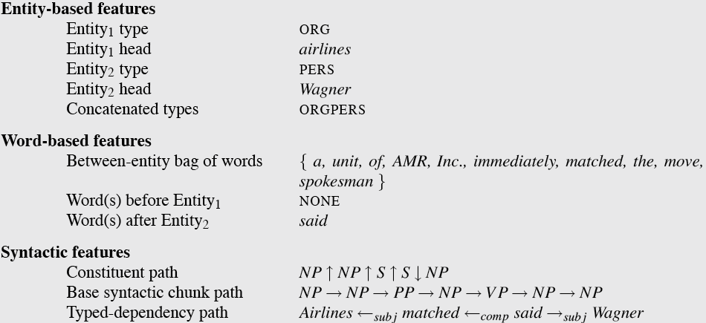
American Airlines, a unit of AMR, immediately matched the move, spokesman Tim Wagner said.

Slide 11
Classifiers for supervised methods
Now you can use any classifier you like
MaxEnt
Naïve Bayes
SVM
...
Train it on the training set, tune on the dev set, test on the test set

Slide 12
Evaluation of Supervised Relation Extraction
Compute P/R/F₁ for each relation

Slide 13
Summary: Supervised Relation Extraction
+ Can get high accuracies with enough hand-labeled training data, if test similar enough to training
- Labeling a large training set is expensive
- Supervised models are brittle, don’t generalize well to different genres

Slide 14
Relation Extraction
Supervised relation extraction

